Slide 1
Team Smart Tow
Jason Stoller
Jon Stembel
Fernando Contreras
John Strong
Brian Fischer

Slide 2
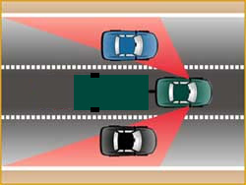
Problem Description
Blind Spots
Wires
Lack of Safety Info
Blind Spot / Coverage

Slide 3
Proposed Solution
Demonstrated Features
Blind Spot Detection
Backup Ranging
Wireless Brake Light and Turn Signals
Wireless Display Console (for Operator)
Indoor & Outdoor Temp Sensors
Door Position Sensor (Open/Closed)

Slide 4
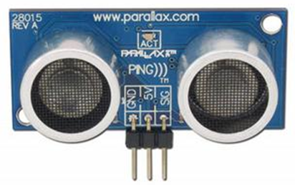
Blind Spot Detection
Cameras
Light Sensors
Capacitive Sensors
Lasers
Acoustic Sensors
Ultrasonic Ranging Sensor

Slide 5
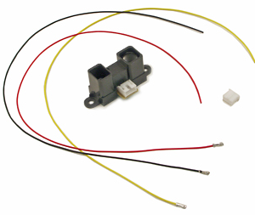
Backup Ranging
Lasers
Ultrasonic
IR
IR Sensor

Slide 6
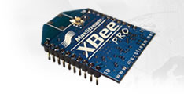
Wireless Communications
Brake Lights, Turn Signals, and Display Console
Bluetooth
WiBree
ZigBee
UWB
Zigbee Chip

Slide 7
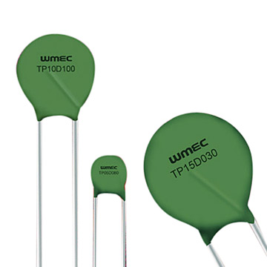
Temperature Sensing
Thermistor
IR
Bi-Metal
IC
Thermistors

Slide 8
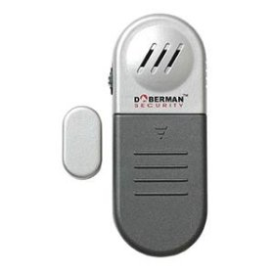
Door Position
Contact Switches
Magnetic
Laser
Magnetic Sensor

Slide 9
Engineering Content
Components to Design
Blind Spot Detection
Indoor & Outdoor Temperature Sensors
Wireless Brake Lights and Turn Signals
Wireless Display Console for Operator
Components to Buy
Backup Ranging Sensor
Door Position Sensor (Open/Closed)

Slide 10
Thank You!

